Slide 1


Which Cloud is My Cloud?
Justin Borgman
CEO, Starburst

Slide 2
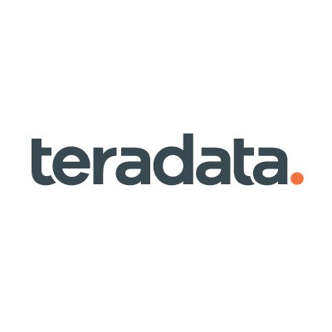
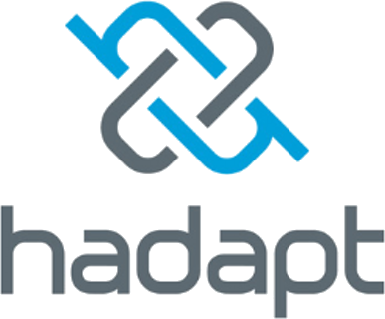

About Me
Founder & CEO
VP & GM
Founder & CEO

Slide 3
We are the Presto Company
See more at https://github.com/prestodb/presto/wiki/Presto-Users

Slide 4

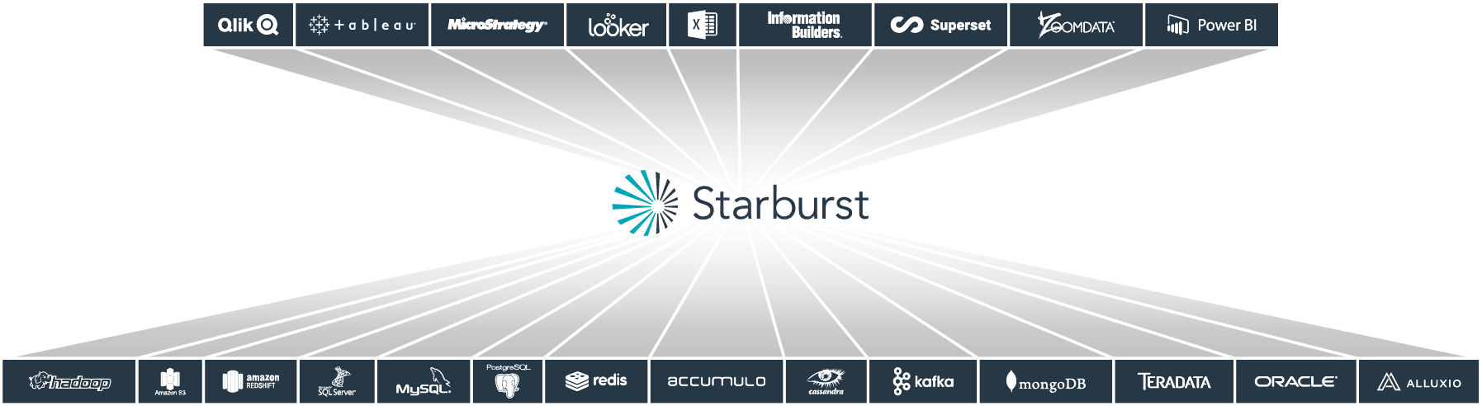
Presto is SQL on anything
Query anything, anywhere

Slide 5
Which Cloud is My Cloud?

Slide 6
I don't know what they want from me. It's like the more [data] we come across, The more problems we see -”Notorious Data Architect”

Slide 7
2012

Slide 9
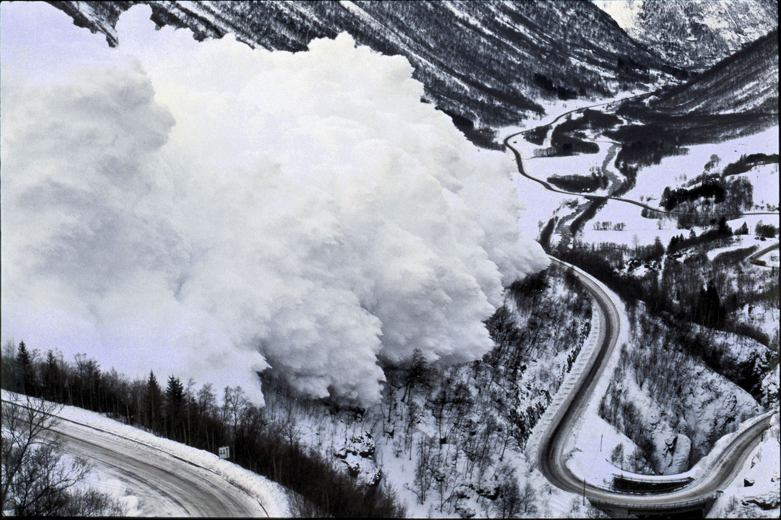

Slide 12
I want to say one word to you. Just one word.
Optionality.

Slide 13
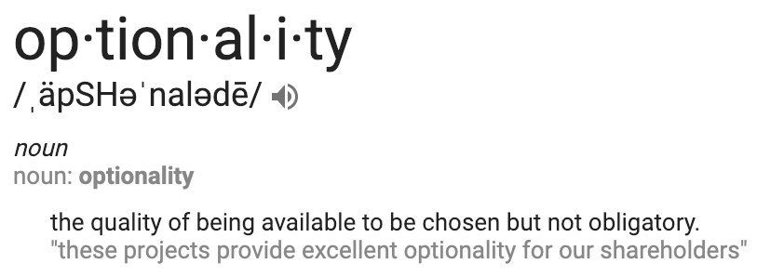

Slide 14
Optionality
from your architecture

Slide 15
Don’t let history repeat itself
3 keys to a cloud architecture that can stand the test of time
Embrace Storage/Compute Separation
Use Open Data Formats
Future-Proof Your Architecture

Slide 16
Don’t let history repeat itself
Embrace Storage / Compute Separation
Compute
Storage
Notes:
In the past, storage and compute were co-located on the same physical machines. But, with the cloud, you now have the ability to separate these two, allowing you to scale them independently. With Blob or ADLS, you don’t have to worry about scaling out storage because Azure handles that for you. However, you can spin up and spin down your compute resources as needed to control for either cost or performance. The net result is maximum efficiency.

Slide 17
Don’t let history repeat itself
Embrace Storage / Compute Separation
Compute
Storage

Slide 18
Don’t let history repeat itself
Embrace Storage / Compute Separation
Compute
Compute
Storage

Slide 19
Don’t let history repeat itself
Embrace Storage / Compute Separation
Compute
Compute
Compute
Storage

Slide 20
Don’t let history repeat itself
Embrace Storage / Compute Separation
Compute
Compute
Compute
Compute
Storage

Slide 21
Don’t let history repeat itself
Use Open Data Formats
ORCFile
Parquet
Avro
SequenceFile
CSV
Notes:
Open data formats prevent vendor lock-in because they let you use many SQL engines to query them

Slide 22
Don’t let history repeat itself
Future-Proof Your Architecture
Compute
Compute
Compute
Compute
ADLS

Slide 23
Don’t let history repeat itself
Future-Proof Your Architecture
Compute
Compute
Compute
Compute
ADLS
SQLServer

Slide 24
Don’t let history repeat itself
Future-Proof Your Architecture
Compute
Compute
Compute
Compute
ADLS
SQLServer
Teradata

Slide 25
Don’t let history repeat itself
Future-Proof Your Architecture
SQL Abstraction Layer
aka
Consumption Layer | Semantic Layer | Query Federation | Query Fabric | Data Virtualization
ADLS
SQLServer
Teradata

Slide 26
Don’t let history repeat itself
Future-Proof Your Architecture
SQL Abstraction Layer
aka
Consumption Layer | Semantic Layer | Query Federation | Query Fabric | Data Virtualization
ADLS
SQLServer
Teradata
Kafka

Slide 27
Don’t let history repeat itself
Future-Proof Your Architecture
SQL Abstraction Layer
aka
Consumption Layer | Semantic Layer | Query Federation | Query Fabric | Data Virtualization
ADLS
SQLServer
Teradata
Kafka
MongoDB

Slide 28
Don’t let history repeat itself
Future-Proof Your Architecture
SQL Abstraction Layer
aka
Consumption Layer | Semantic Layer | Query Federation | Query Fabric | Data Virtualization
ADLS
SQLServer
Teradata
Kafka
MongoDB
X

Slide 29
Don’t let history repeat itself
3 keys to a cloud architecture that can stand the test of time
Embrace Storage/Compute Separation
Use Open Data Formats
Future-Proof Your Architecture

Slide 30
Optionality
from your cloud provider

Slide 32
And let's change the way we treat each other. You see the old way wasn't working so it's on us to do What we gotta do, to survive [in the cloud] -”Data Analyst”

Slide 33
Questions?

